Slide 1
Lfoundry general Fab overview
Fabrizio Marchili / LFoundry Facility Leader
LFoundry, Avezzano 17 Settembre 2020

Slide 2
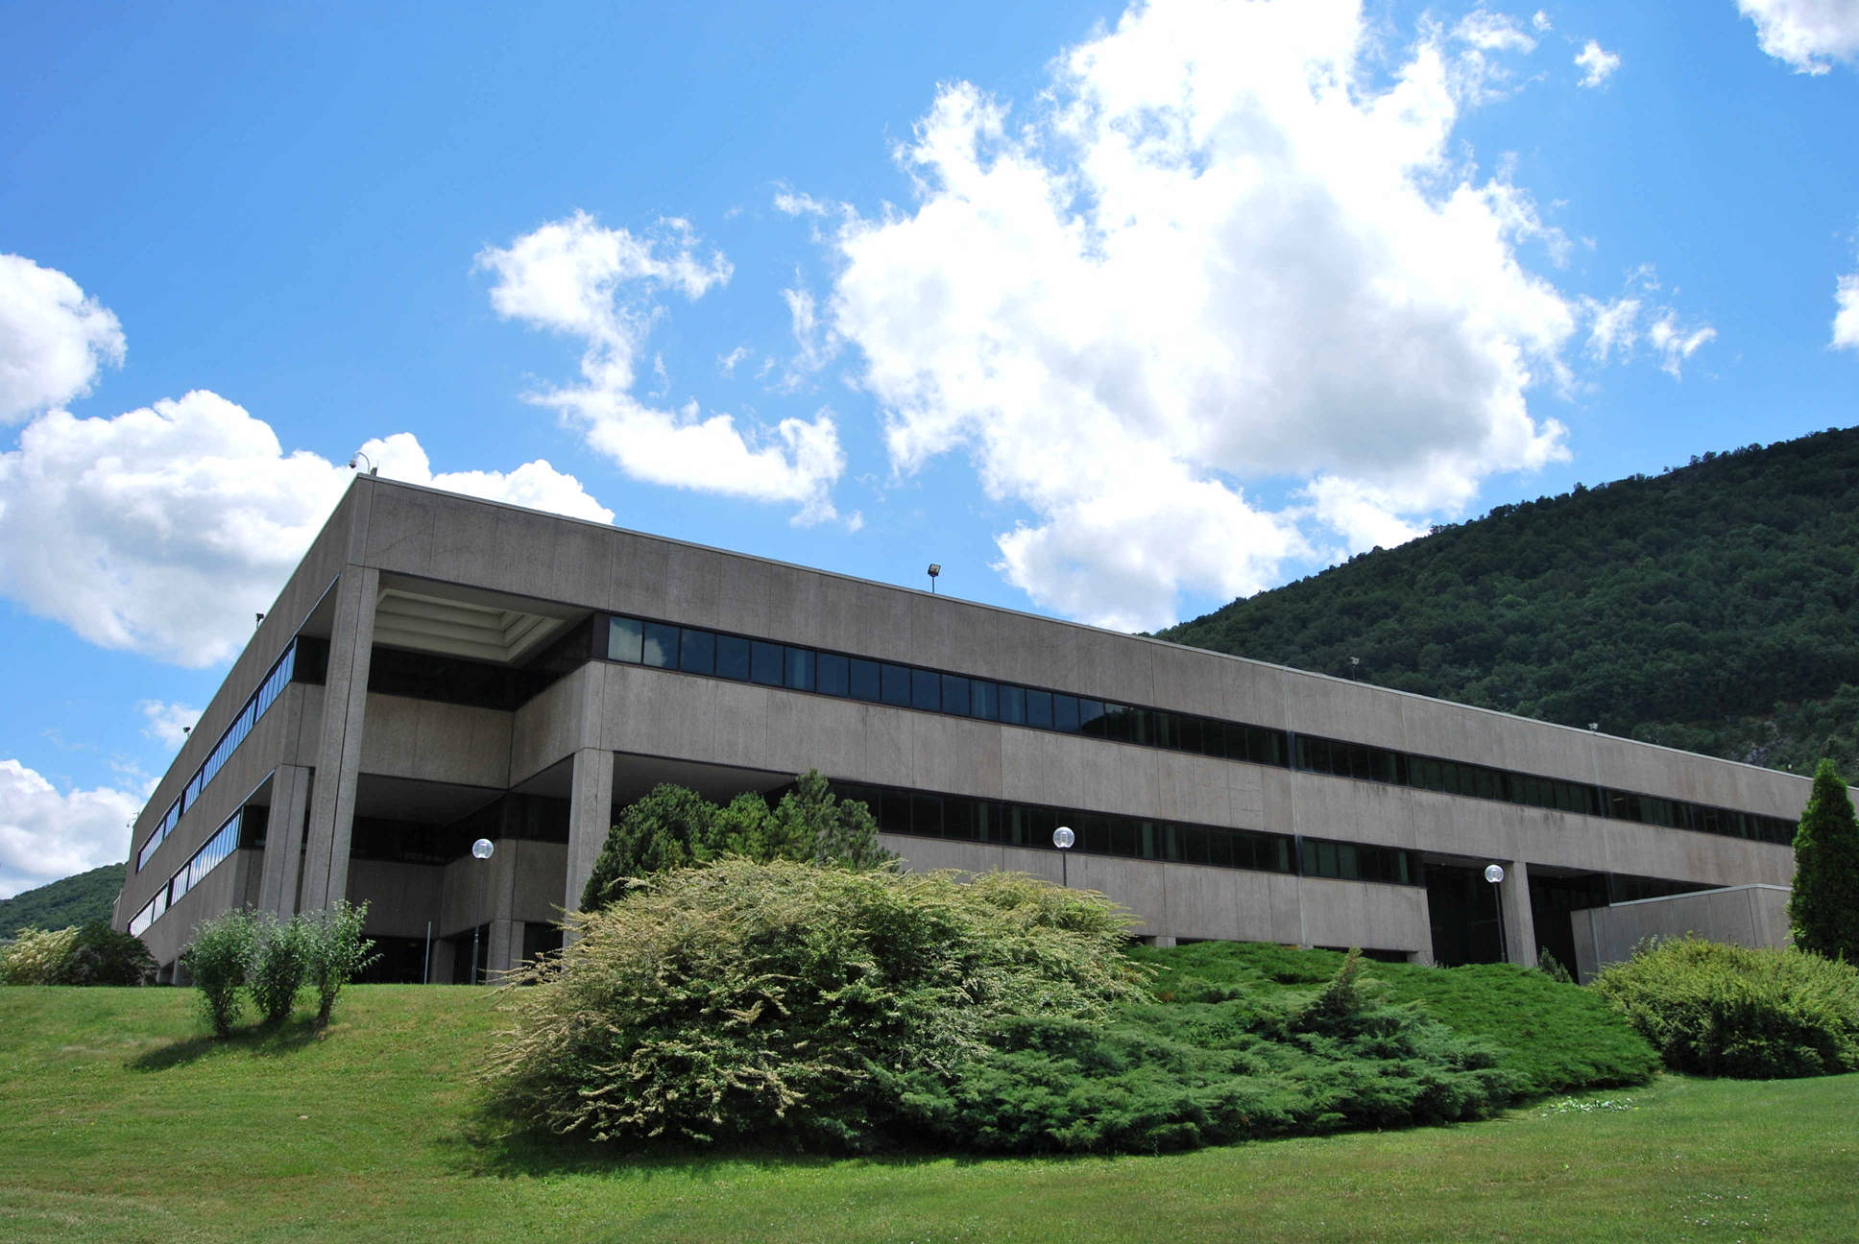
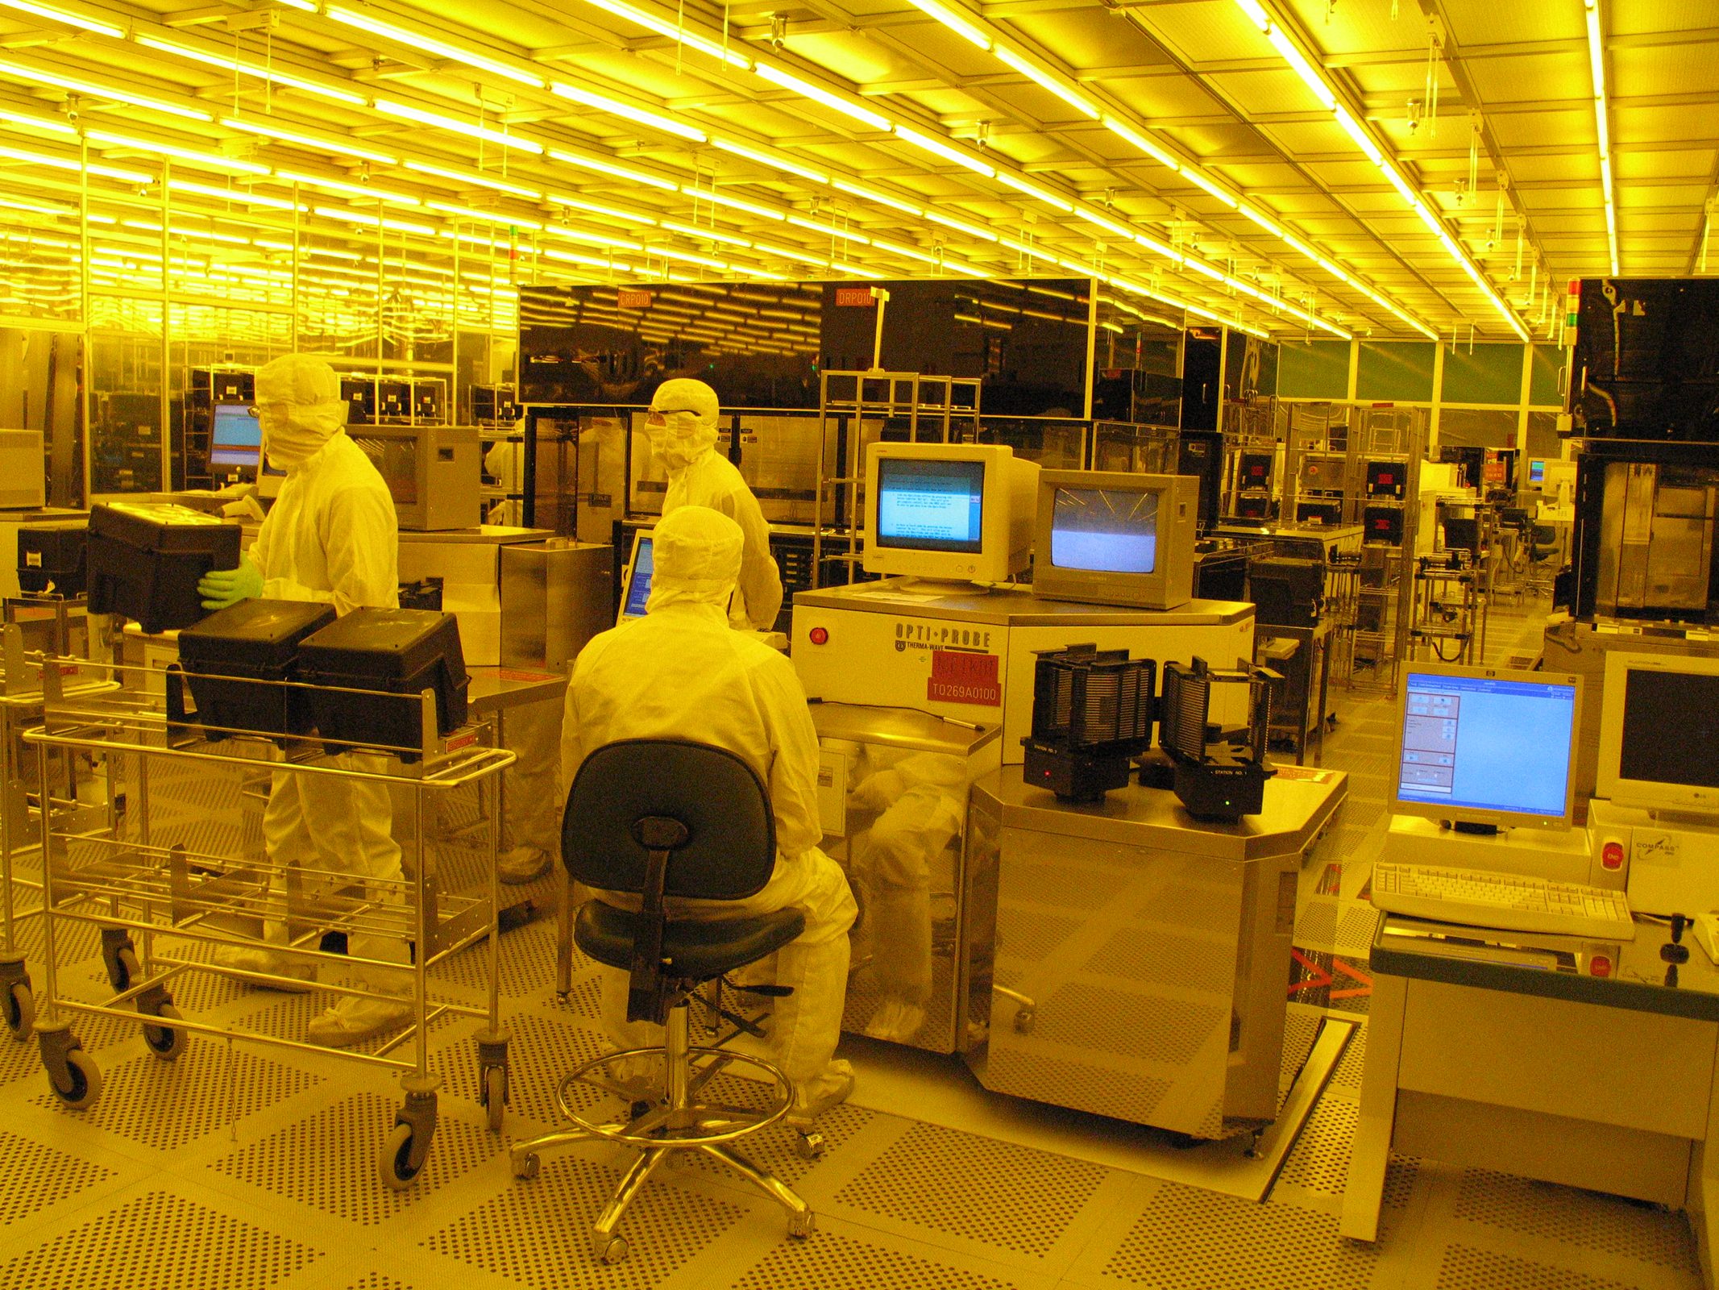
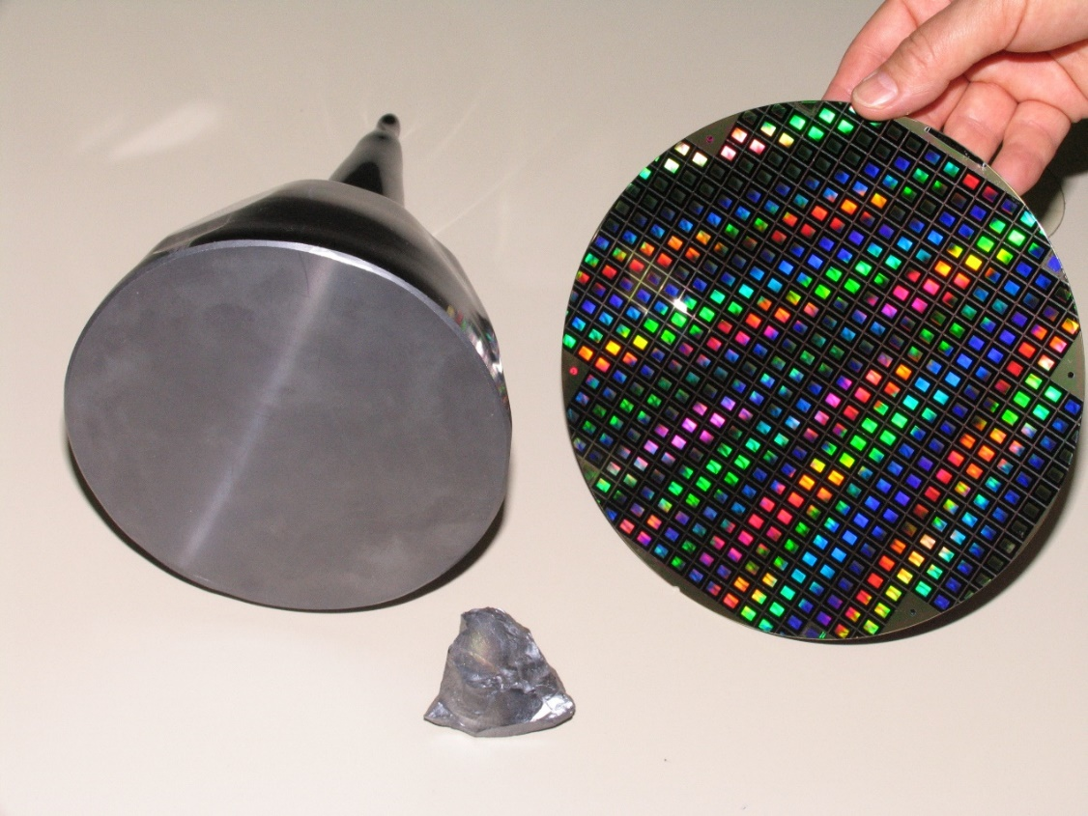
SITE OVERVIEW
Founded in 1989 by Texas Instruments
Class: Front-end Semiconductor (B2B)
Production Cycle: continuous 365gg x 24h
Employees: +1.400 direct
Clean room ISO-3: 11.000m³
Clean room ISO-5: 1.000m³
Production unit: 200mm Silicon Wafer
Production capacity: 40.000 wf/month
Technology Node: up to 90nm

Slide 3
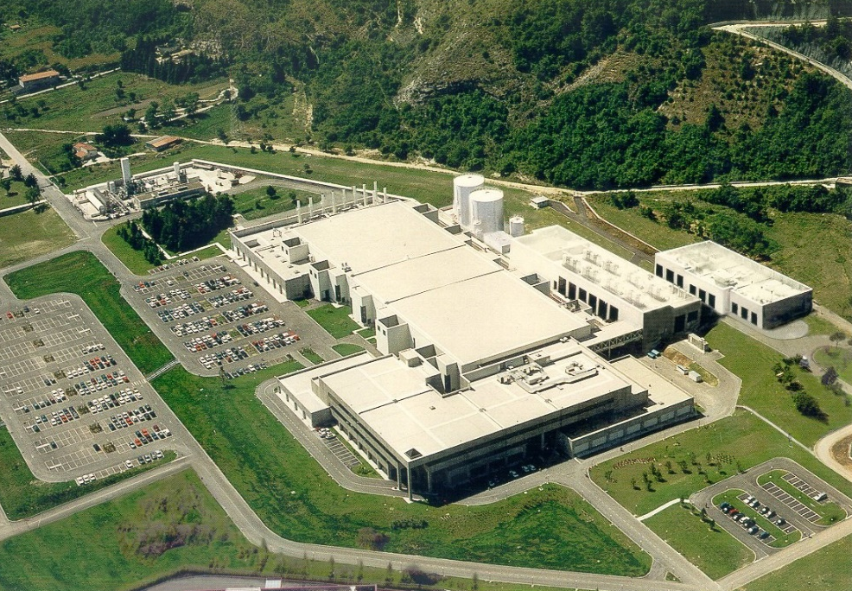
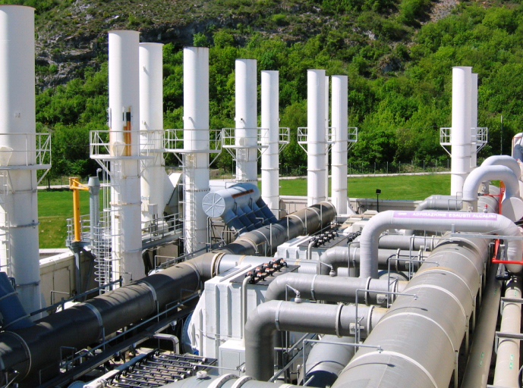
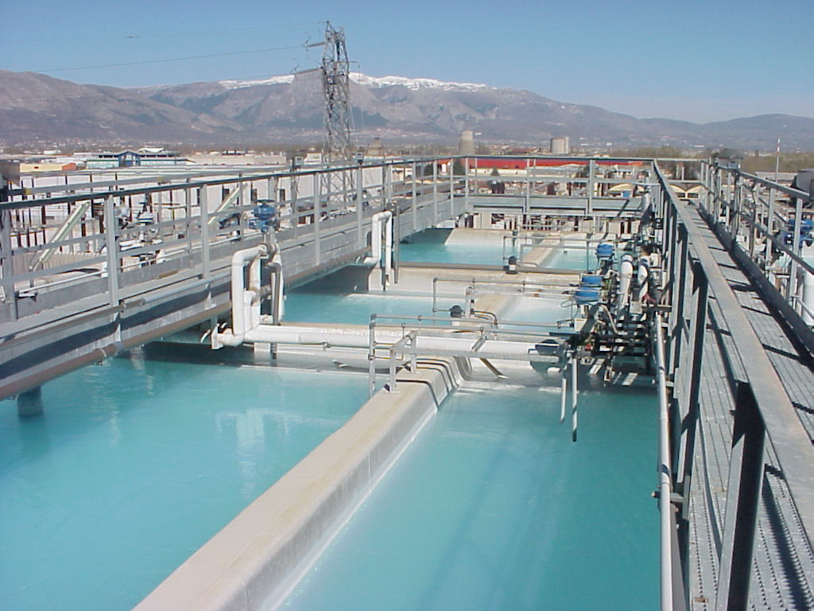
LFOUNDRY FACILITIES OVERVIEW
LFoundry plant is self producing / managing all the utilities with specifically designed plant
Technical Gas : Oxygen 1.400 m³/h, Nitrogen 6.500 m³/h
Chemical & Gases : Inert, Flammable, Corrosive, Toxic, Pyrophoric
Cogeneration : 89.6 MWt, 36.6 Mwe
Thermal plant : 21MWt
Refrigeration plant : 29.6 MWf,
Compressed Dry Air : 7.600 m³/h
Deionized Water : 110 m³/h
Clean room HVAC : 8.150.000 m³/h
Conveyed Air
640.000 m³/h
Waste-water
230 m³/h

Slide 4
FRONT END SEMICONDUCTOR PROCESS
We are Here
Bare Silicon
Process
Semi-finish good
Finish Good
SURFACE CLEANING
OXIDATION DIFFUSION
LAYER DEPOSITION
ION IMPLANT
MATERIAL ETCHING
CHEMICAL MECHANICAL POLISH
IN LINE METROLOGY
ELECTRICAL TEST
PHOTO PATERNING
Semiconductor device production is long and complex
Model : Job Shop
Iteraction : +500
Cycle Time : up to 90 days
Materials: + 200 Chemical & gases
Equipment: + 200 Technologies

Slide 5
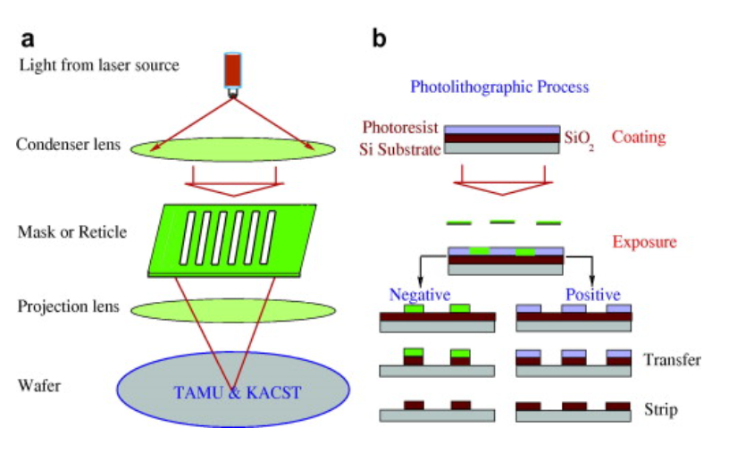
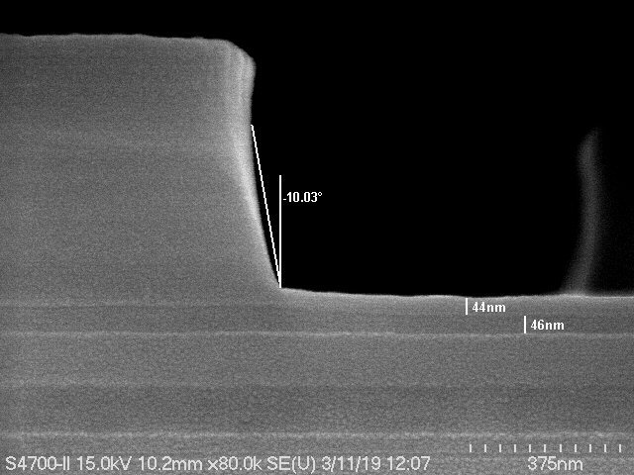
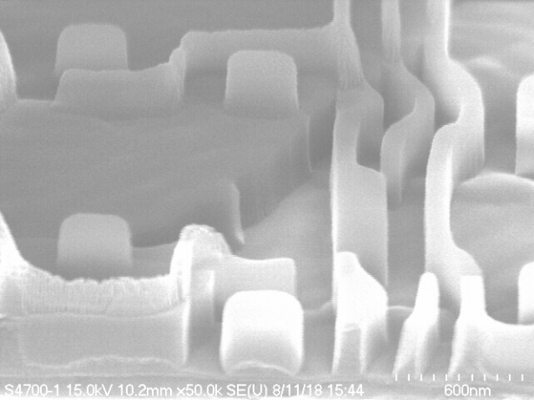
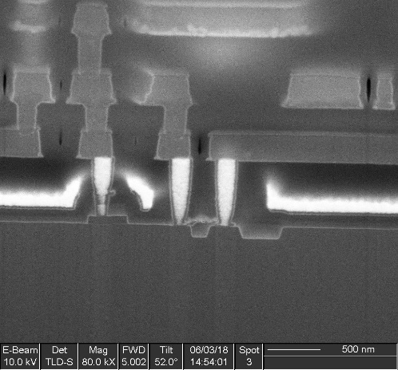
SEMICONDUCTOR PROCESS CRITICALITIES
Realizing a nano-structure do require the correct combination of :
Equipment technology, Material, Process and finally Recipe
CRITICAL PARAMETERS
Dimensional tolerances
Uniformity across wafer
Chemical , Physical & Electrical properties
Material Selectivity, Directionality, Reaction speed

Slide 6
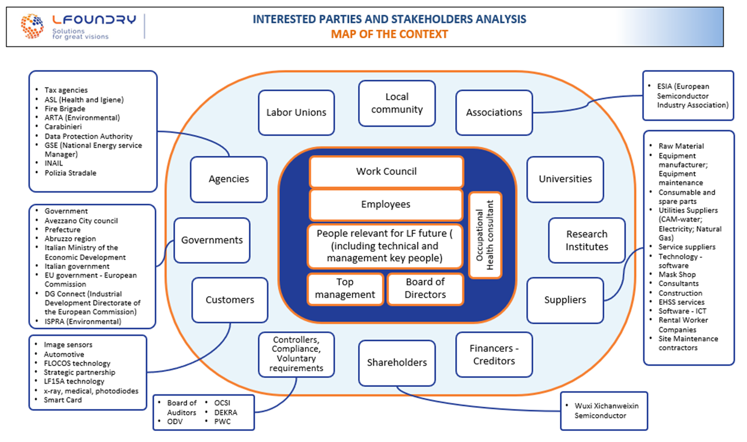
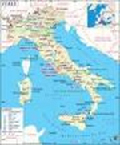
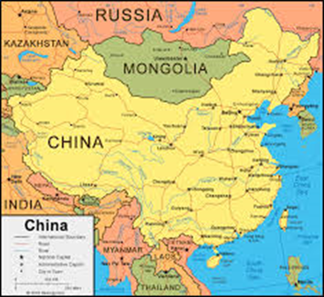
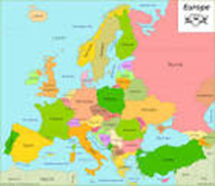
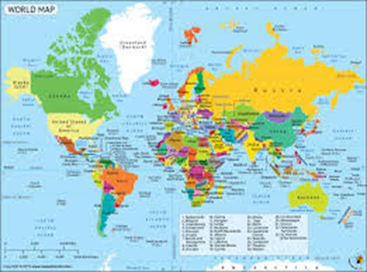
A COMPLEX & SPREAD STAKEHOLDER NETWORK
Semiconductors do require various type of advanced and specialty materials, technology, product & services.
Stakeholders are spread across the world with annexed requirement & complexity

Slide 7
NEW MATERIAL DEVELOPMENT IN SEMICONDUCTOR
We start here

Slide 8
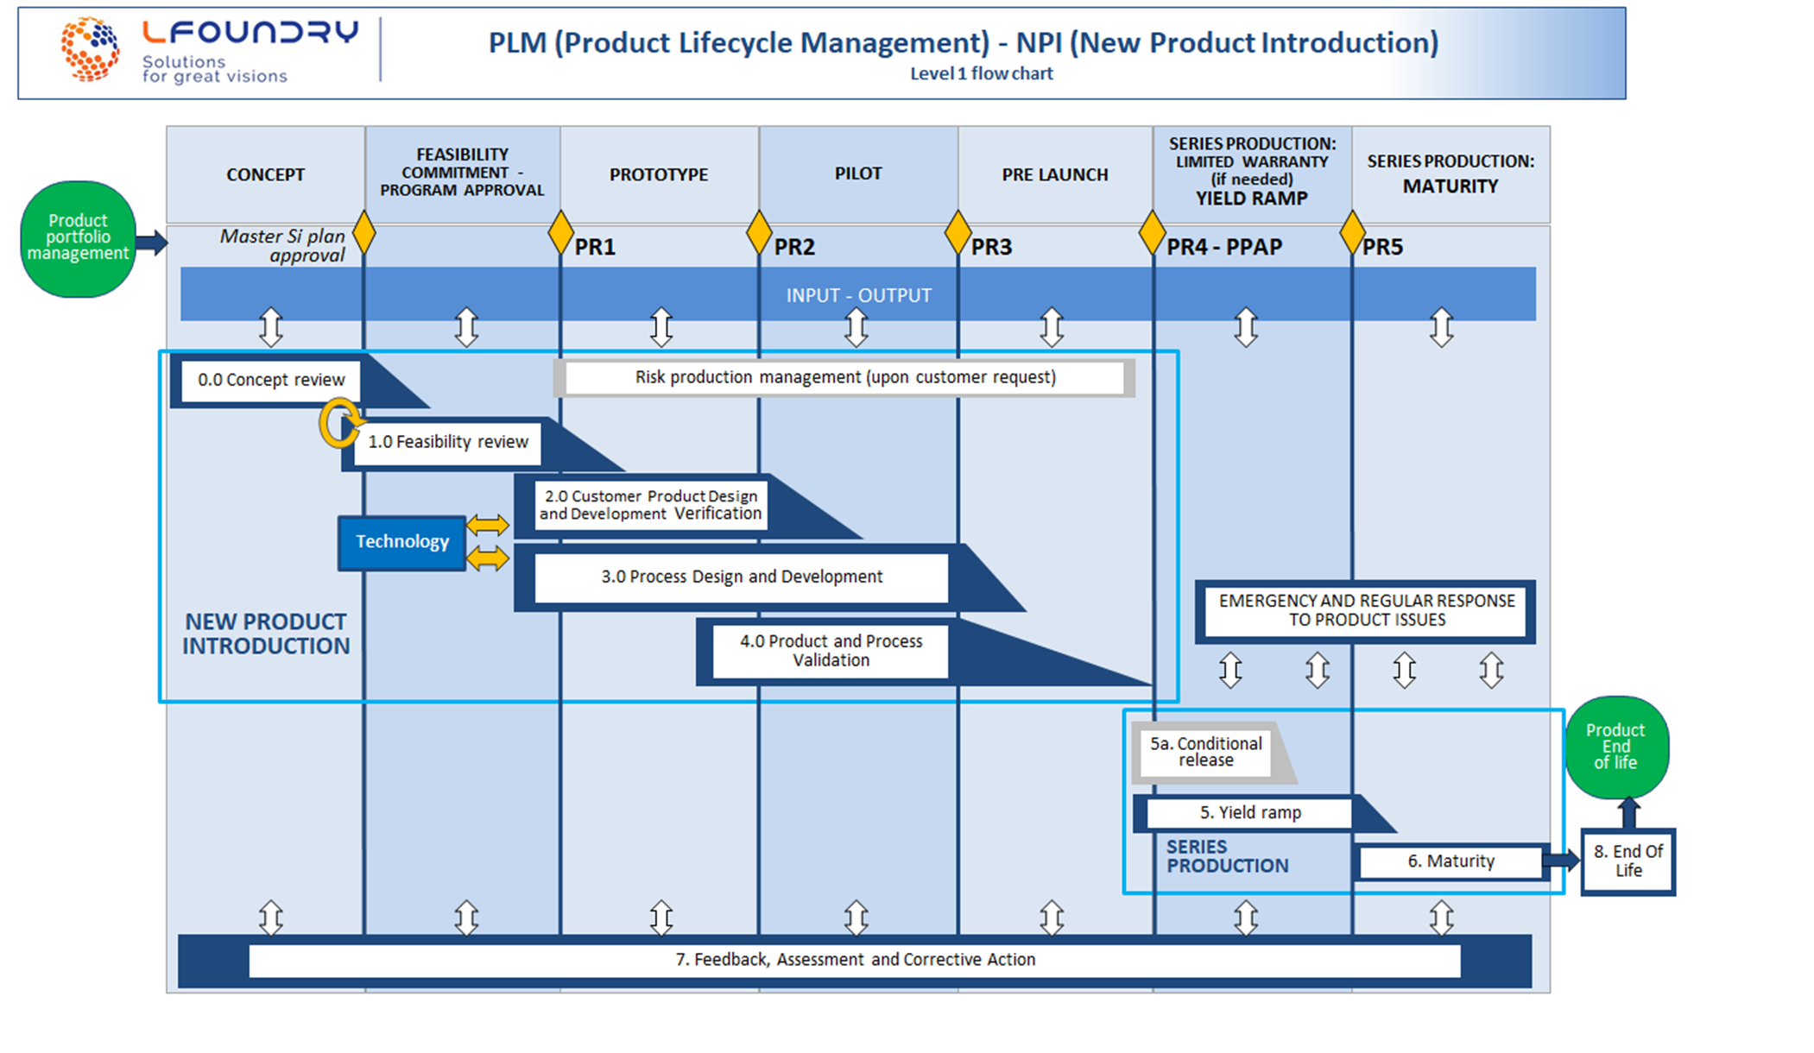
OUR NEW PRODUCT / TECHNOLOGY DEVELOPMENT
The Job is not finished Once the set “Material-Process-Technology” is validated in the Semiconductor world
Any change must be verified and tested in the Specific product production process to debug it and eliminate any adverse effect on form-fit & function as well as on reliability of the device
LFoundry follow Strict IATF Automotive requirement to release a product to the customer

Slide 9
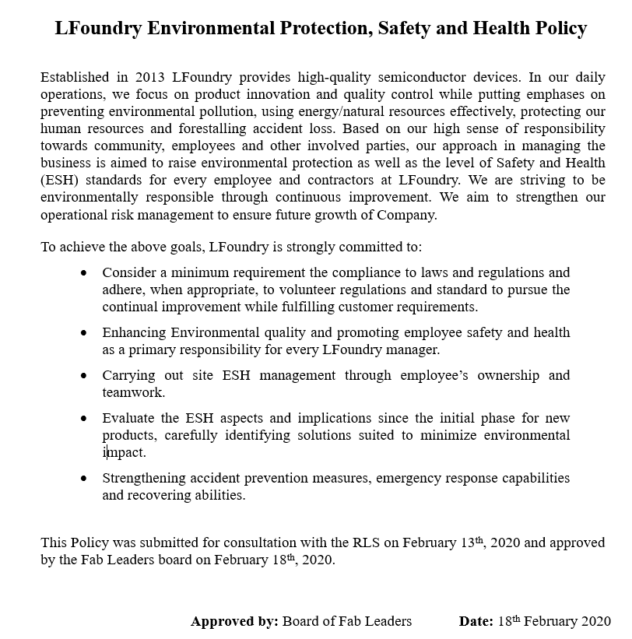
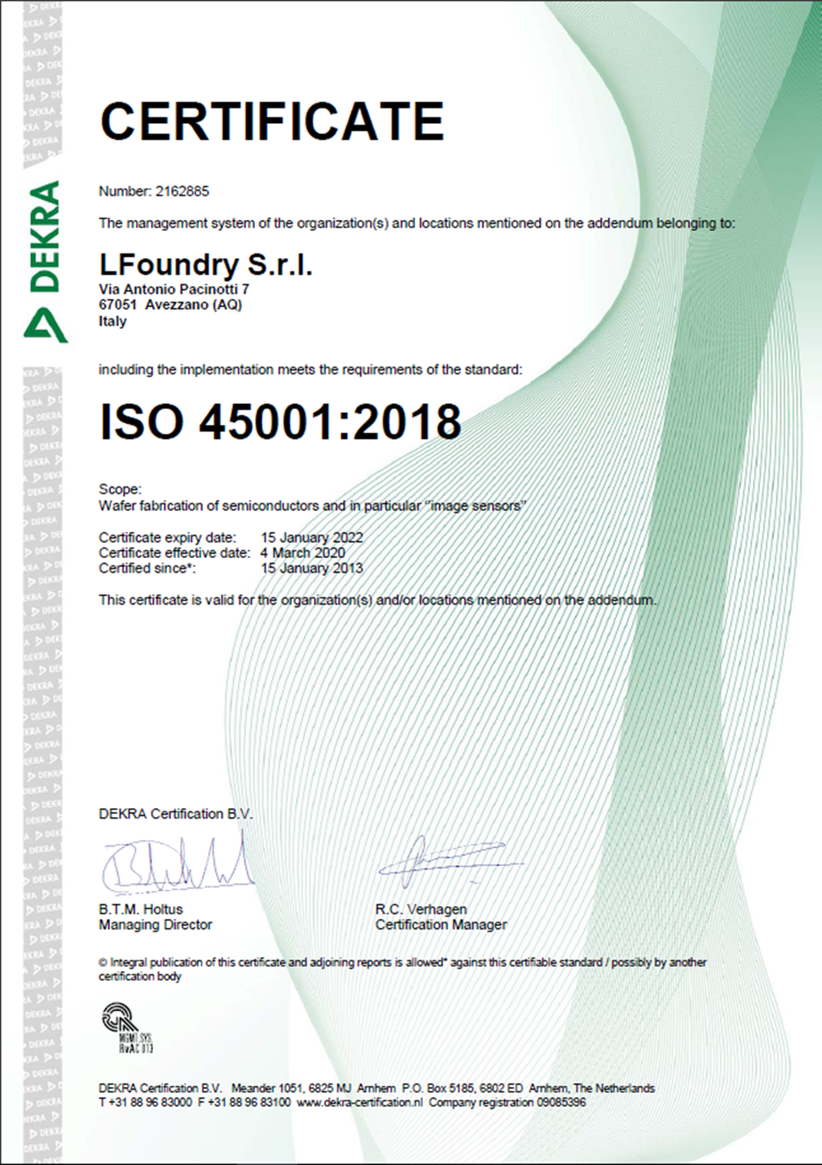
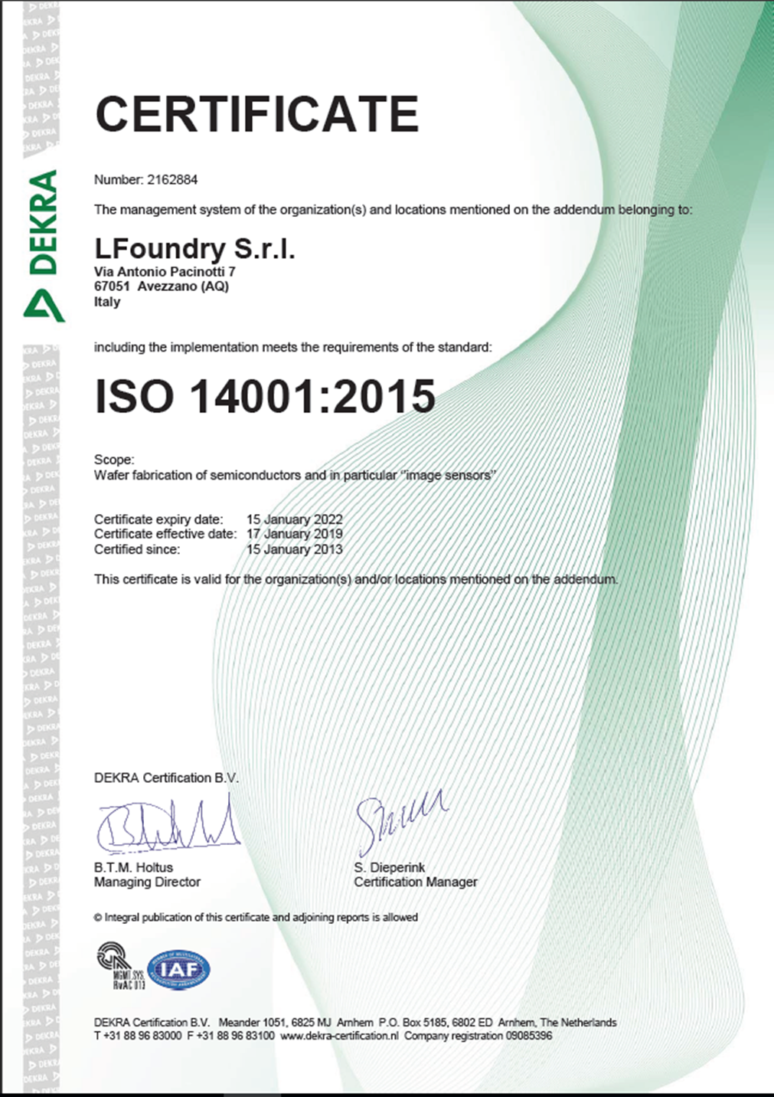
OUR COMMITMENT TOWARD ENVIROMENT & SAFETY

Slide 10
LFOUNDRY ENVIRONMENTAL ASPECTS
IN
Natural Gas 35,000,000 m³
Power 140,000 MWh
Silicon 20,000 Kg
Industrial Water 1,400,000 m³
Chemical & Gases 2,900,000 Kg
PRODUCT
Silicon 19,700 Kg
OUT
Air Emission
Combustion 1,970 10E6 Nm³
Solvent 2,120 10E6 Nm³
Acid 2,410 10E6 Nm³
Water discharge 1,300,539 m³
Total Waste 3,850,000 Kg
Process
Air Emission
Combustion
Air Emission
Water
Discharge
Water
Chemical
& Gas
Power
Waste
Data referred to Annual 2020 AIA report

Slide 11
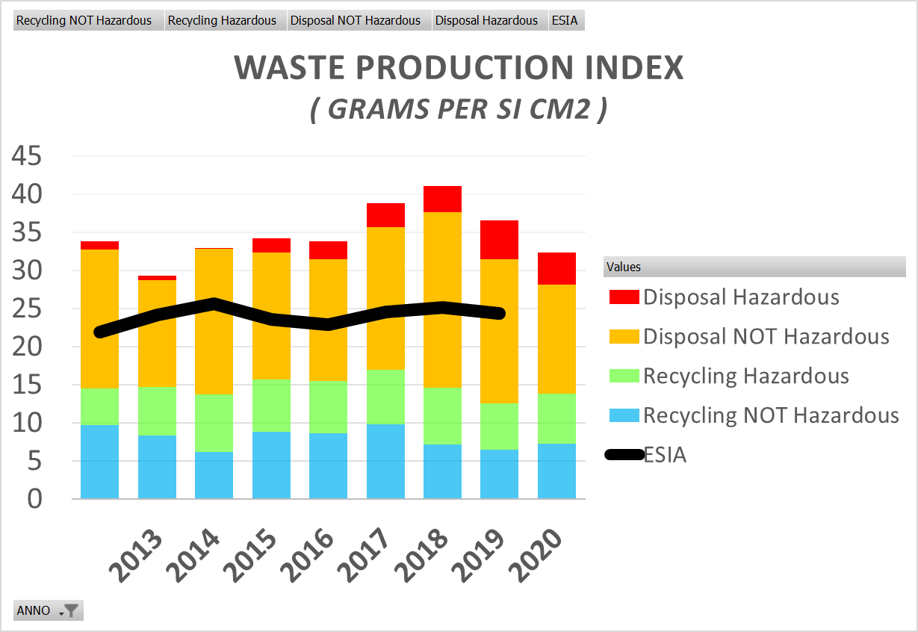
WHY LIFEBITMAP
Material replacement is a long, complex and economically unfeasible option !
Alternative solutions to improve environmental aspects are the reduction of waste disposal & water discharge pollution joint with reduction of hazardous substances storage and annexed risk
SEZ, BOE & TMAH were identified because of their contribution to Waste & Seveso Index, while limited to TMAH the Environmental prescription regarding water pollution reduction.
NOTE : Waste index highlight a gap between LFoundry & the European Semiconductor Industries. This is driven by the fact that TMAH account for 25% of the index, while none of the European industry has today any waste water treatment, nor limit or prescription applied to surface water release
 | Seveso Index | Annual Waste | Water discharge
SEZ (HNA-HNP) Nitric, Acetic, Hydrofluoric, Phosphoric |  | 278 Ton 7.2% of total
BOE Ammonium Fluoride | YES | 487 Ton 12.7% of Total
TMAH |  | 966 Ton 25.1% of total | YES

Slide 12
Thank You very much for your attention !
This Project receives funding form the European Union Life Programme Under Grant Agreement N. LIFE 15 ENV/IT 000332.

